Slide 1
High availability and scalability on GNU/Linux clusters
Pieter Libin

Slide 2
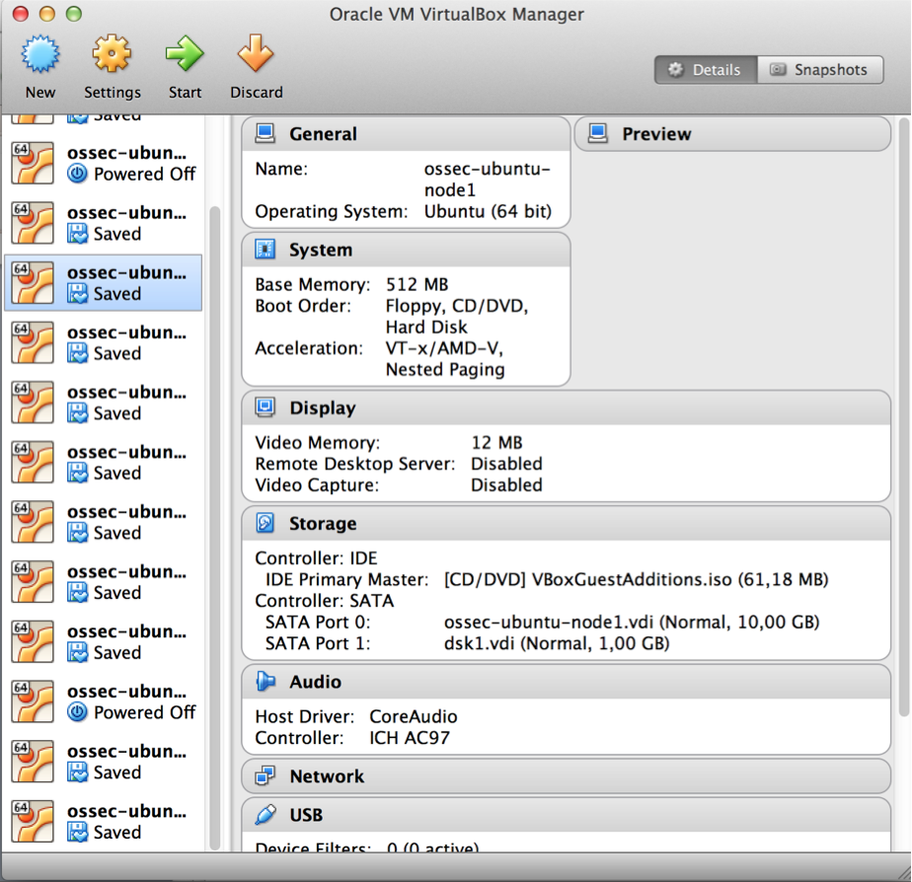
Simulated environment

Slide 3
Experiments
Ganglia: distributed monitoring system
DRBD: network based RAID-1
MySQL replication
HAProxy setup

Slide 4
Nagios experiment
Node 1
Controller
[MacOS X]
VBox

Slide 5
Nagios experiment
Node 1
Kernel panic
Controller
[MacOS X]
VBox

Slide 6
Nagios experiment
Node 1
Kernel panic
Controller
[MacOS X]
VBox
Start replacement VM
Node 2

Slide 7
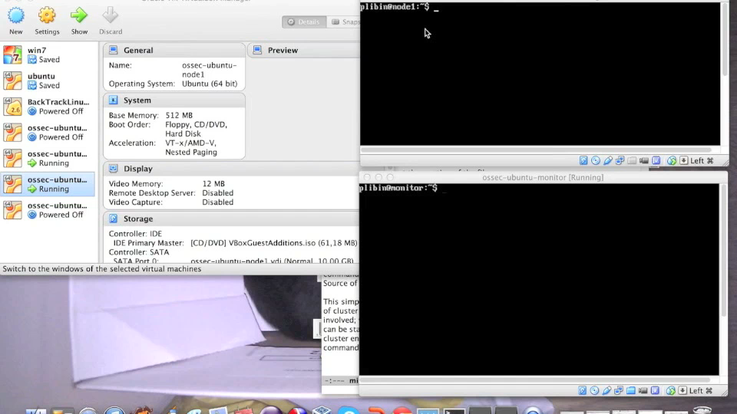
Nagios experiment

Slide 8
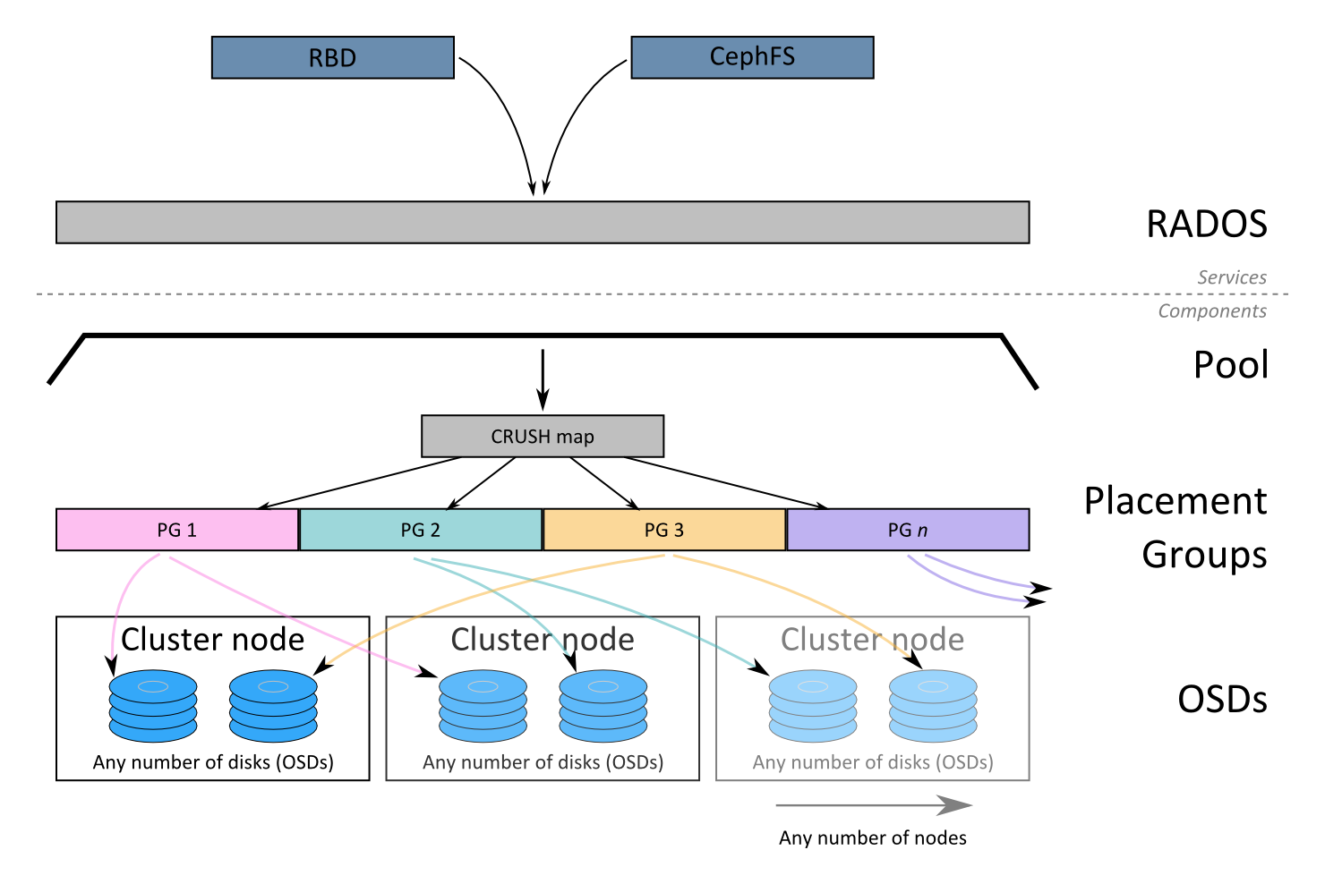
Ceph: distributed object storage

Slide 9

Ceph experiment
RADOS commands
Node 1
Monitor
Ceph Admin
Node 2
Disk 1
Node 3
Disk 2

Slide 10
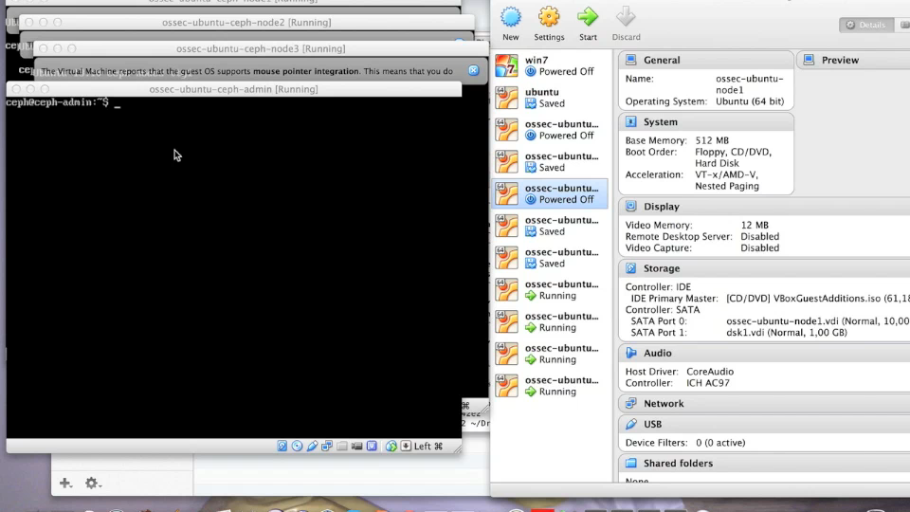
Ceph experiment

Slide 11
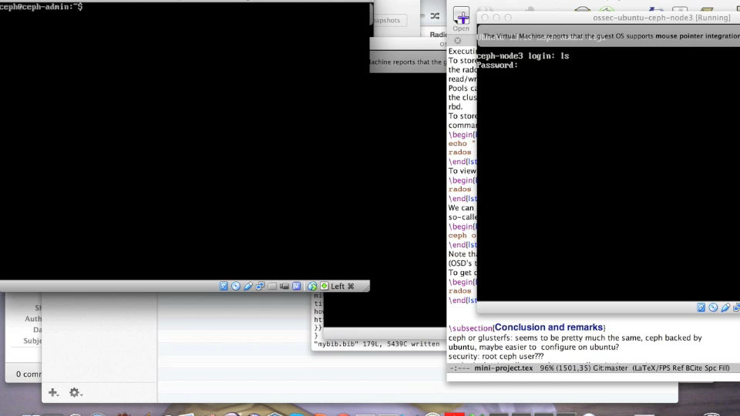
Ceph experiment

Slide 12
Shards experiment
Shard 1
MySQL
Application
[Java]
Shard 2
MySQL
Simple schema:
users and posts
Decides which shard(s) to contact

Slide 13
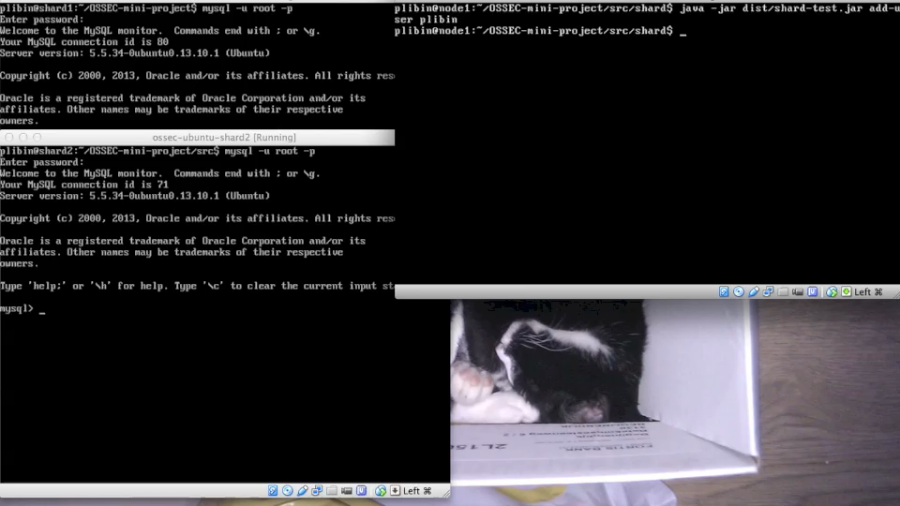
Shards experiment

Slide 14
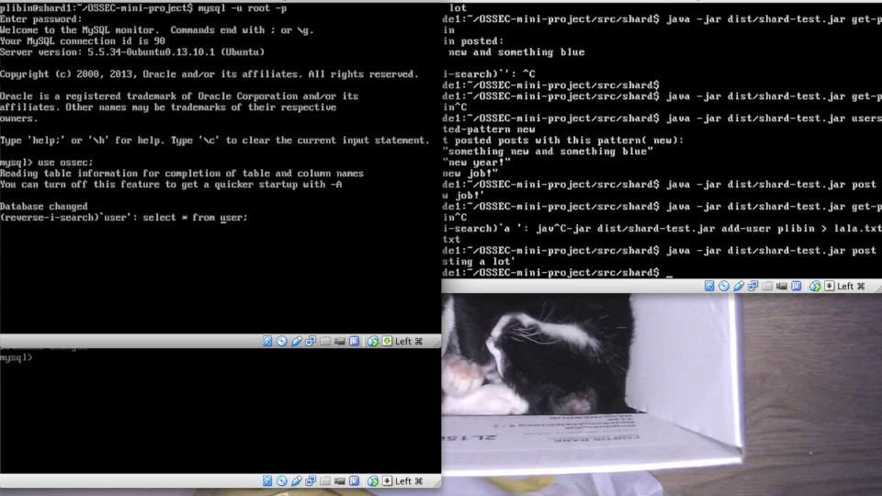
Shards experiment

Slide 15

Wikipedia clone: architecture
edits
editor
Content
[git]
informs
informs
fetches
fetches
Http 1
Http 2
HAProxy
views
user

Slide 16
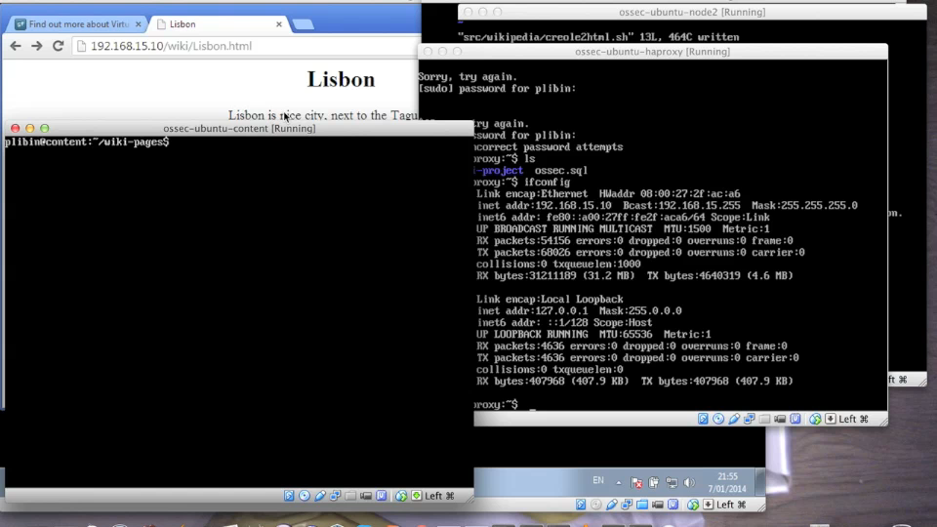
Wikipedia clone

Slide 17
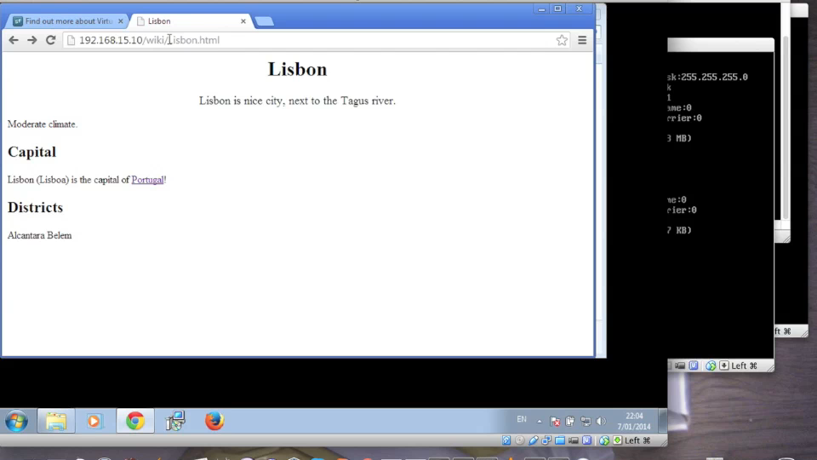
Wikipedia clone

Slide 18
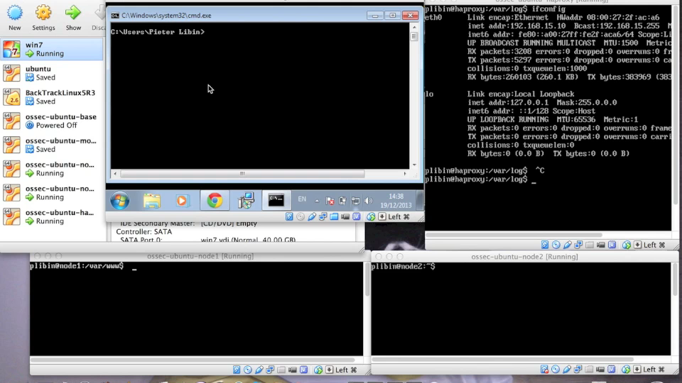
HAProxy fail experiment

